Slide 1
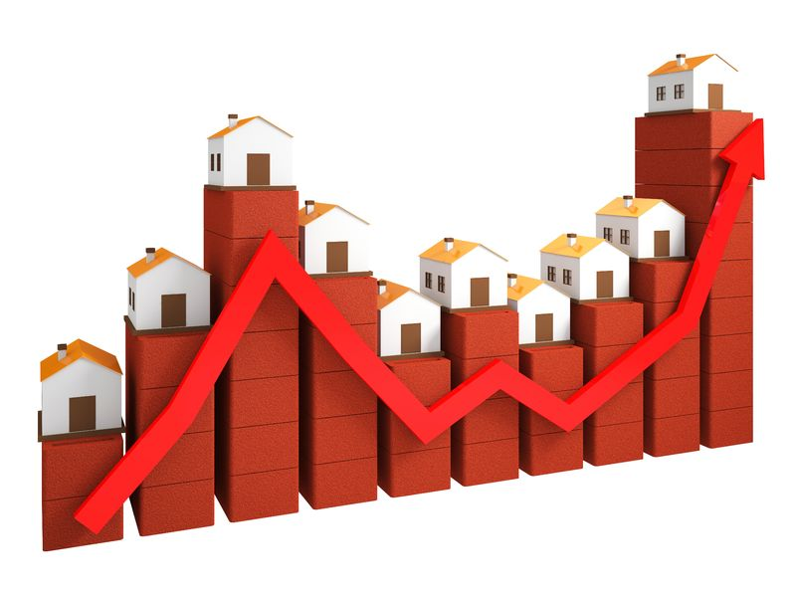
Houses Price Prediction
By : Yogesh Chandra

Slide 2
HousePriceData : Building Price prediction ML model
Term 2
Notebook by Yogesh Chandra Ramakrishna
Supported by Levi Nigam
Source of the Data : INSAID

Slide 3
Required libraries
NumPy: Provides a fast numerical array structure and helper functions.
pandas: Provides a DataFrame structure to store data in memory and work with it easily and efficiently.
matplotlib: Basic plotting library in Python; most other Python plotting libraries are built on top of it.
Seaborn: Advanced statistical plotting library.
cufflinks: interactive graphs
Scikit-learn: is a machine learning library for the Python programming language.

Slide 4
Problem Statement
I am trying to build a ML Prediction model, where my clients who are the top Real Estates company can use this model in their Website as a service. This website is visited by millions of customers every year. This Model will help the end users to estimate or to know the present market prices of the houses based on few inputs they provide.
Let us see how we can build a Model using prehistoric data provided by our client.

Slide 5
Data Description
The dataset comprises of 1460 observations of 81 columns. Below is a table showing names of all the columns.
'Id', 'MSSubClass', 'MSZoning', 'LotFrontage', 'LotArea', 'Street', 'Alley', 'LotShape', 'LandContour', 'Utilities', 'LotConfig', 'LandSlope', 'Neighborhood', 'Condition1', 'Condition2', 'BldgType', 'HouseStyle', 'OverallQual', 'OverallCond', 'YearBuilt', 'YearRemodAdd', 'RoofStyle', 'RoofMatl', 'Exterior1st', 'Exterior2nd', 'MasVnrType', 'MasVnrArea', 'ExterQual', 'ExterCond', 'Foundation', 'BsmtQual', 'BsmtCond', 'BsmtExposure', 'BsmtFinType1', 'BsmtFinSF1', 'BsmtFinType2', 'BsmtFinSF2', 'BsmtUnfSF', 'TotalBsmtSF', 'Heating', 'HeatingQC', 'CentralAir', 'Electrical', '1stFlrSF', '2ndFlrSF', 'LowQualFinSF', 'GrLivArea', 'BsmtFullBath', 'BsmtHalfBath', 'FullBath', 'HalfBath', 'BedroomAbvGr', 'KitchenAbvGr', 'KitchenQual', 'TotRmsAbvGrd', 'Functional', 'Fireplaces', 'FireplaceQu', 'GarageType', 'GarageYrBlt', 'GarageFinish', 'GarageCars', 'GarageArea', 'GarageQual', 'GarageCond', 'PavedDrive', 'WoodDeckSF', 'OpenPorchSF', 'EnclosedPorch', '3SsnPorch', 'ScreenPorch', 'PoolArea', 'PoolQC', 'Fence', 'MiscFeature', 'MiscVal', 'MoSold', 'YrSold', 'SaleType', 'SaleCondition', 'SalePrice'

Slide 6
Descriptive statistics
Lets have a look at ‘SalePrice’ which is our Dependent Variable, lets try to measure the IQR.
The interquartile range (IQR) is the difference between the upper (Q3) and lower (Q1) quartiles, and describes the middle 50% of values when ordered from lowest to highest. The IQR is often seen as a better measure of spread than the range as it is not affected by outliers.
Q3-Q1 = 51,000
The variance and the standard deviation are measures of the spread of the data around the mean. They summarise how close each observed data value is to the mean value. In datasets with a small spread all values are very close to the mean, resulting in a small variance and standard deviation. Where a dataset is more dispersed, values are spread further away from the mean, leading to a larger variance and standard deviation.
If we see the above values we can say that spread of the data is mostly concentrated in Q1 and Q2.
count | mean | std | min | 25% | 50% | 75% | max
SalePrice | 1460.0 | 180921.195890 | 79442.502883 | 34900.0 | 129975.00 | 163000.0 | 214000.00 | 755000.0

Slide 7
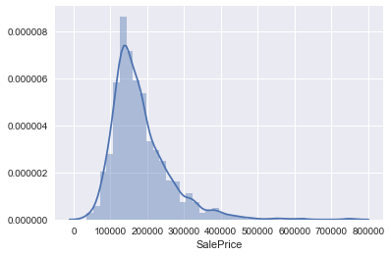
Sale Price Distribution

Slide 8
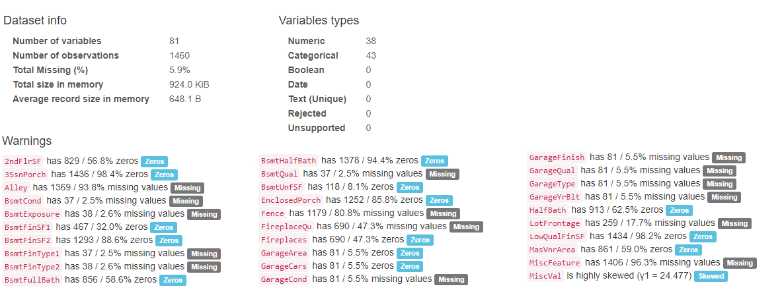
Objectives & Graphs
If we look at the Pandas Profiling as shown below we can understand that there are lot of missing values.

Slide 9
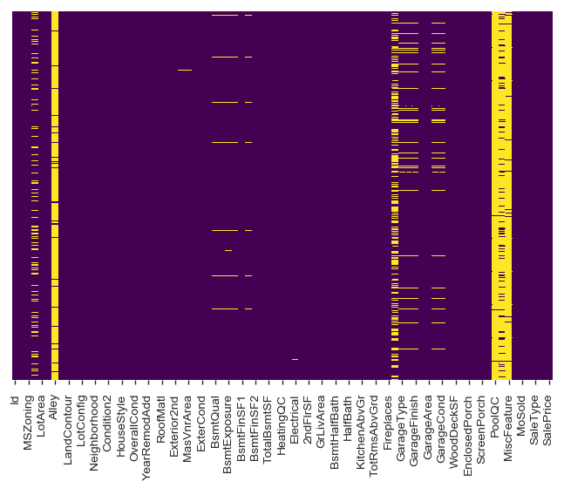
Below Spread show the missing values
Tracked in Google Analytics

Slide 10
Correlation of Numerical Data Columns with respect to SalePrice
We can see there is Negative and Positive correlation, but we will select the parameter with threshold above -0.5 and 0.5
OverallQual 0.790982
GrLivArea 0.708624
GarageCars 0.640409
GarageArea 0.623431
TotalBsmtSF 0.613581
1stFlrSF 0.605852
FullBath 0.560664
TotRmsAbvGrd 0.533723
YearBuilt 0.522897
YearRemodAdd 0.507101
GarageYrBlt 0.486362
MasVnrArea 0.477493
Fireplaces 0.466929
BsmtFinSF1 0.386420
LotFrontage 0.351799
WoodDeckSF 0.324413
2ndFlrSF 0.319334
OpenPorchSF 0.315856
HalfBath 0.284108
LotArea 0.263843
BsmtFullBath 0.227122
BsmtUnfSF 0.214479
BedroomAbvGr 0.168213
ScreenPorch 0.111447
PoolArea 0.092404
MoSold 0.046432
3SsnPorch 0.044584
BsmtFinSF2 -0.011378
BsmtHalfBath -0.016844
MiscVal -0.021190
Id -0.021917
LowQualFinSF -0.025606
YrSold -0.028923
OverallCond -0.077856
MSSubClass -0.084284
EnclosedPorch -0.128578
KitchenAbvGr -0.135907

Slide 11
Multicollinearity
Multicollinearity : is the biggest problem in variable selection
Attribute Pair | Correlation
4 | (GarageArea, GarageCars) | 0.88248
22 | (GarageYrBlt, YearBuilt) | 0.82567
24 | (GrLivArea, TotRmsAbvGrd) | 0.82549
15 | (1stFlrSF, TotalBsmtSF) | 0.81953
8 | (2ndFlrSF, GrLivArea) | 0.6875
20 | (BedroomAbvGr, TotRmsAbvGrd) | 0.67662
23 | (BsmtFinSF1, BsmtFullBath) | 0.64921
9 | (GarageYrBlt, YearRemodAdd) | 0.64228
5 | (FullBath, GrLivArea) | 0.63001
10 | (2ndFlrSF, TotRmsAbvGrd) | 0.61642
17 | (2ndFlrSF, HalfBath) | 0.60971
27 | (GarageCars, OverallQual) | 0.60067
7 | (GrLivArea, OverallQual) | 0.59301
0 | (YearBuilt, YearRemodAdd) | 0.59286
11 | (GarageCars, GarageYrBlt) | 0.58892
6 | (OverallQual, YearBuilt) | 0.57232
21 | (1stFlrSF, GrLivArea) | 0.56602
13 | (GarageArea, GarageYrBlt) | 0.56457
18 | (GarageArea, OverallQual) | 0.56202
1 | (FullBath, TotRmsAbvGrd) | 0.55478
12 | (OverallQual, YearRemodAdd) | 0.55068
16 | (FullBath, OverallQual) | 0.5506
3 | (GarageYrBlt, OverallQual) | 0.54777
25 | (GarageCars, YearBuilt) | 0.53785
14 | (OverallQual, TotalBsmtSF) | 0.53781
2 | (BsmtFinSF1, TotalBsmtSF) | 0.5224
26 | (BedroomAbvGr, GrLivArea) | 0.52127
19 | (2ndFlrSF, BedroomAbvGr) | 0.5029

Slide 12
Skewness, Kurtosis, Data Transformation, converting and New Features
Skewness is a measure of symmetry, or more precisely, the lack of symmetry A distribution, or data set, is symmetric if it looks the same to the left and right of the centre point.
Kurtosis is a measure of whether the data are heavy-tailed or light-tailed relative to a normal distribution.
Data Transformation: I have used log transformation to reduce Skewness and Kurtosis. It has worked very well and you can see the result in the notebook.
Converting Categorical Features: Categorical features are converted to Numerical data “LabelEncoder”.
Creating New Feature: #'GarageYrBlt','YearBuilt','YearRemodAdd', 'YrSold‘ these columns are categorised based on year.

Slide 13
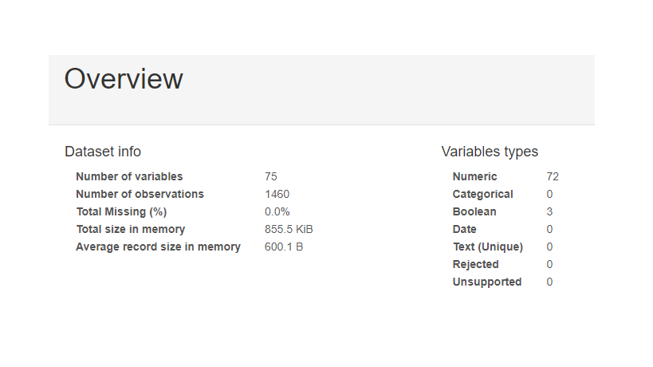
Post Profiling
We can see that there are no missing values in the Data set now. And also columns which are not required are removed

Slide 14
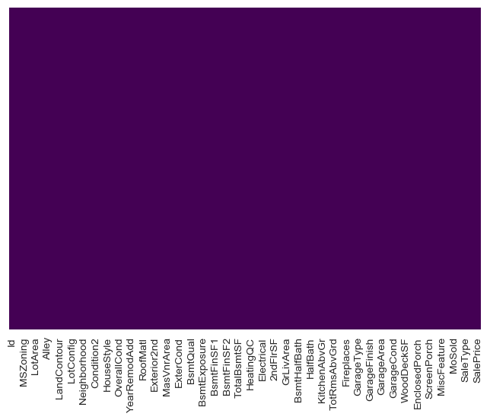
After all the missing data was imputed

Slide 15
Conclusion for EDA
Overall Quality parameter has highest correlation with SalePrice , but same time it has Multi-correlation with many other parameters, we can include this in set of input parameters and compare the results and decide. surprisingly Height of the basement and Exterior material quality has some impact on SalePrice. Negative correlated and Positive correlation parameters with respect to Sale Price, we can see there are many negative and positive correlated parameters in the data set, we can use them effectively in Model building. we shall have a threshold like 0.5 for positive parameters and -0.5 for negative parameters. Other parameters with very less correlation and also very less Multi-correlation can be considered , but will see if they can do any effect on the Model accuracy.

Slide 16
Machine Learning Data Model
We are going to use bunch of Algorithms to get the best prediction possible. I will use the following Algorithms.
Linear Regression
Hyper-parameter optimizers - GridSearchCV
Decision Tree Regressor
Hyper-parameter optimizers - GridSearchCV
Random Forest Regressor
Hyper-parameter optimizers - RandomizedsearchCV

Slide 17
Linear Regression
Regression Evaluation Metrics: Compared to Random Search Results, Grid Search results looks not improvised as shown below.
- Regression Evaluation Metrics : Set B - Normal Search
- MAE: 0.12474512444157672
- MSE: 0.026966218087775433
- RMSE: 0.16421393999224132
- Regression Evaluation Metrics : Set B - Grid Search CV
- MAE: 0.12474512444157679
- MSE: 0.0269662180877755
- RMSE: 0.16421393999224151

Slide 18
Decision Tree Regressor
Lets Compare the RMSE calculation DT Model.
Regression Evaluation Metrics : DT Model (All Data)
MAE: 0.14730287685012552
MSE: 0.04531865234984309
RMSE: 0.2128817802204855
Regression Evaluation Metrics : DT Model (Set C)
MAE: 0.16218285497815974
MSE: 0.05209127154248255
RMSE: 0.22823512337605392
Regression Evaluation Metrics : DT Model (Set B)
MAE: 0.16061820919999564
MSE: 0.04978371299632755
RMSE: 0.22312264115577232

Slide 19
Decision Tree Regressor – Grid Search
Regression Evaluation Metrics : DT Model( GridSearch DT)
MAE: 0.14112033391236184
MSE: 0.040514434327341
RMSE: 0.201281977154789
Regression Evaluation Metrics : DT Model( GridSearch DT - Set C)
MAE: 0.14125006055240488
MSE: 0.03647823612376357
RMSE: 0.19099276458484907
Regression Evaluation Metrics : DT Model( GridSearch DT - Set B)
MAE: 0.14118955167506164
MSE: 0.03602255297245313
RMSE: 0.18979608260565636

Slide 20
Random Forest Regressor
Lets Compare the RMSE calculation of Random Forest Model.
Regression Evaluation Metrics : Random Forest Model(Model1)
MAE: 0.10456434350871413
MSE: 0.021658608450583205
RMSE: 0.14716863949423195
Regression Evaluation Metrics : Random Forest Model(Model2)
MAE: 0.1027739112758477
MSE: 0.021589752288459583
RMSE: 0.1469345170082904
Regression Evaluation Metrics : Random Forest Model(Set C)
MAE: 0.12134337912280597
MSE: 0.028713191378259773
RMSE: 0.16944967211021617

Slide 21
Random Forest Regressor
Regression Evaluation Metrics : Random Forest Model(Set B)
MAE: 0.12067498055631946
MSE: 0.02874356108553383
RMSE: 0.16953926119201365

Slide 22
Random Forest Regressor- RandomSearchCV
Regression Evaluation Metrics : Random Forest Model(RandomizedSearch CV)
MAE: 0.12467021015415798
MSE: 0.03175791876384326
RMSE: 0.17820751601389673
Regression Evaluation Metrics : Random Forest Model(RandomizedSearch CV - Set C)
MAE: 0.12970907364189407
MSE: 0.0327637495142158
RMSE: 0.1810075951837817
Regression Evaluation Metrics : Random Forest Model(RandomizedSearch CV - Set B)
MAE: 0.1282104523036054
MSE: 0.032744294550992745
RMSE: 0.18095384646642013

Slide 23
Model Selection
Compare the results of Linear Regression Models
Model Performance Average Error: 0.1176 degrees. Accuracy = 99.02%. Model Performance Average Error: 0.1176 degrees. Accuracy = 99.02%.
Improvement of 0.00%.
As we can see from above that GridSearch model tuning has no improvement when applied on our linear model.
We shall Compare the Linear Grid Model result with the best output of the Decision tree model below.

Slide 24
Model Selection
Compare the results of Linear Regression Model and Decision tree Regression model results.
Model Performance
Average Error: 0.1176 degrees.
Accuracy = 99.02%.
Model Performance
Average Error: 0.1110 degrees. Accuracy = 99.07%.
Improvement of 0.05%.
Distribution model looks performing well now, lets compare DT with Random forest.

Slide 25
Model Selection
Compare the results of Linear Regression Model and Random Forest Model
Model Performance Average Error: 0.0577 degrees. Accuracy = 99.52%. Model Performance Average Error: 0.1110 degrees. Accuracy = 99.07%.
Improvement of -0.45%.
Random forest model looks performing very well compared to other models.

Slide 26
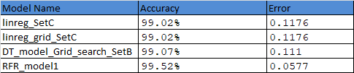
Overall Model Comparison
We can clearly see that Random forest Model has given very good results. So we will be using random forest Model for our client application

Slide 27
Conclusion
ML projects are inherently uncertain and the approach i have used is accountable for hitting a specific accuracy goal.
I have performed error analysis for each model, I have tried to tune the models to get accurate results.
I have tried to implement all of my ideas as much as possible. I have done some trial and error to see how it works.
I have explored and performed Data Analysis and Data Cleaning to build my ML Model as accurate as possible.
Things which i have not performed in depth is Handling Outliers , i have used some basic outliers removal technique, but I strongly believe, because of this i had to compromise with the accuracy of my model.
Z-Score, IQR and others techniques are not implemented, will try to implement it next time.
Why i have not used Logistic regression: since i am building a prediction model where we have continues data dependent variable. Next time if i work on clarifier model definitely i will use Logistic Regression.
Overall the Model looks good and Random forest model has given 99.52% accuracy. Will try to tune up the model in future.

Slide 28
Reference
https://towardsdatascience.com
https://www.khanacademy.org/
https://machinelearningmastery.com
https://www.kaggle.com/
https://medium.com/
https://www.hackerrank.com/
https://scikit-learn.org/
https://www.statisticssolutions.com/

